Slide 1
Intro to Handshake for Employers
Spring 2023

Slide 2
Agenda
Handshake Overview
Live Connections
Getting Started - Creating an Account + Initial Setup
Additional Resources
Posting Jobs
Measuring Performance
Messaging Candidates

Slide 3
Handshake is the only recruiting platform that integrates with 1400+ US academic institutions to verify student credentials
750k+
employers
The Handshake network continues to grow - review the About section on our website to check for the latest stats on # of users, education partners, and employers.
12M+
1400+
students & alumni
Schools
Notes:
Handshake gives you access to the largest network of students and alumni in the US
With over 11 million activated college students and recent alumni, Handshake is used by over 1,400 universities in the US and UK. Today about 75% of the total US university population has access to Handshake at their school.
Unlike social networks (Linkedin), job boards (Indeed) and point solutions (Yello), Handshake powers 91% of the top 500 4-year institution career service centers in the US, offering easy access to qualified early talent and engagement tools at scale
If you need access to state specific stats to show coverage of schools in your area, reach out to your Handshake relationship manager for help
Note: The Handshake network continues to grow so you can review the About section on our website to check for the latest stats on # of users, education partners, and employers. Reach out to your Handshake relationship manager if you have questions!

Slide 4
How Handshake Can Help You
Grow your school network
Build brand presence
Source qualified and diverse talent
Nurture relationships
Fill recruiting funnel
Notes:
Before using a more scaled approach to recruiting, many employers tended to recruit from a small set of core schools - we recommend leveraging Handshake to broaden your reach because it helps you 1) expand your pool of qualified candidates overall leading to more job views and qualified applicants, 2) broaden your brand recognition - helps get the word out about your company to a much broader audience, 3) Access a more diverse group of candidates and 4) ensure a stable pipeline for future hiring needs

Slide 5
Creating Company Account
Create an employer user account
Join your existing company or create a new one
Customize your company profiles, invite teammates + configure roles
If you received an invite from a school or a colleague, create a account via the link provided. Or sign up without an invite here.
Once you’ve confirmed your email, you will be prompted to search for your company + request to join existing company or create a new profile if your employer is not yet on Handshake.
Set up your profile page and branding, invite teammates and configure roles - see here
For more visit Getting Started with Handshake for Employers
Notes:
Getting an account set up is a quick and easy process- either follow the prompts your receive via invite or sign up for yourself via this link and Handshake will guide you through the process: https://app.joinhandshake.com/employer_registrations/new

Slide 6
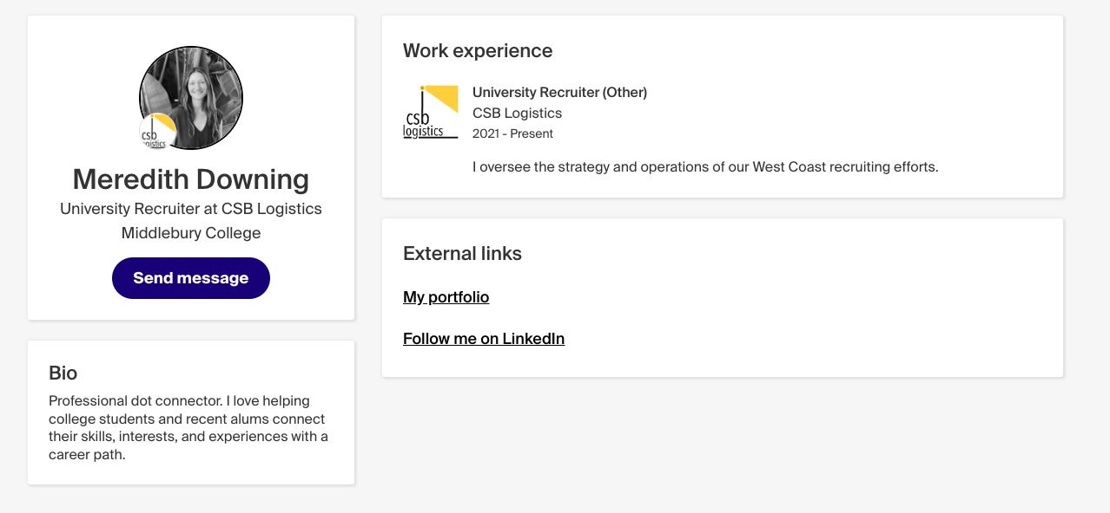
Getting Started:
#1 Fill out your profile
Student view
Notes:
Let’s review some key tips to getting started in Handshake:
#1: fill out your personal profile: you want prospective candidates to be able to see your profile, understand who you are and what you do. To do this, click on the My profile tab on the left navigation bar, see prompts to upload your profile photo and fill out your work experience. From the account tab, fill out your bio, check the “visible on company profile” if you’d like to show up on your company’s page under public contacts for candidates to see and potentially reach out to you

Slide 7
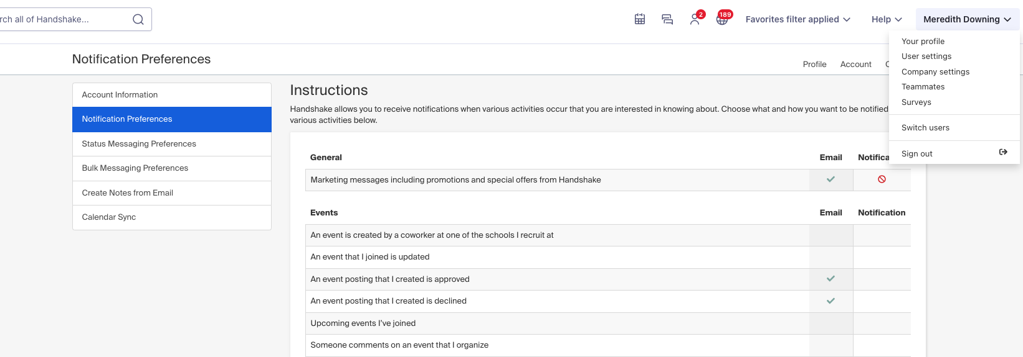
Getting Started:
#2 Review Notification Preferences
Notes:
After setting up your profile, navigate to the drop down menu under your name, select user settings, and then notification preferences on the left. You have the option to receive in app notifications and/or email notifications for a variety of activities like events, interview schedules, jobs, messages and more

Slide 8
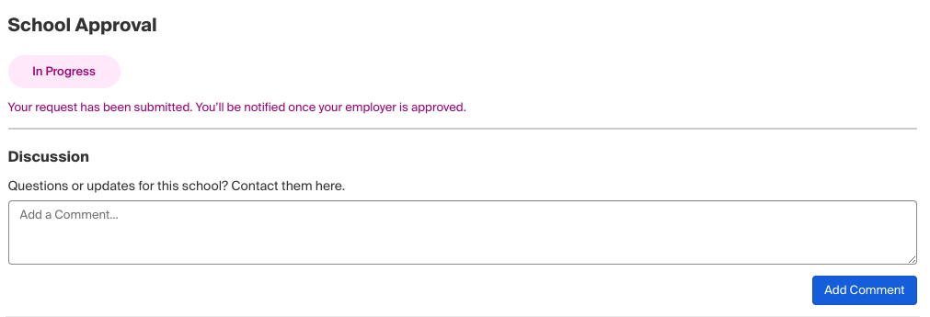
Getting Started:
#3 Review School Connections
View existing connections, add to favorites + discover more schools to connect with
Communicate directly with the career services office at schools you are looking to connect with
Additional Resources
School Network Management
How to Get Approved by More Schools
Notes:
Review your school connections by clicking on “schools”, your employer’s schools to see who you are already connected with. From here, you can favorite any schools you want to keep track of on your favorites tab. Use the more school on Handshake tab to search for additional specific schools to connect with, review the status of any connection requests and communicate directly with schools by clicking into their profile
PRO TIP: Periodically you can filter by date joined on the “more schools on Handshake” tab and request to connect with partners who have recently joined
ADDITIONAL RESOURCES:
School Network Management https://support.joinhandshake.com/hc/en-us/articles/360018956834-School-Network-Management-Requesting-Adding-and-Removing-Schools
How can I get approved by schools? https://support.joinhandshake.com/hc/en-us/articles/115014792607-How-Can-I-Get-Approved-By-Schools-

Slide 9
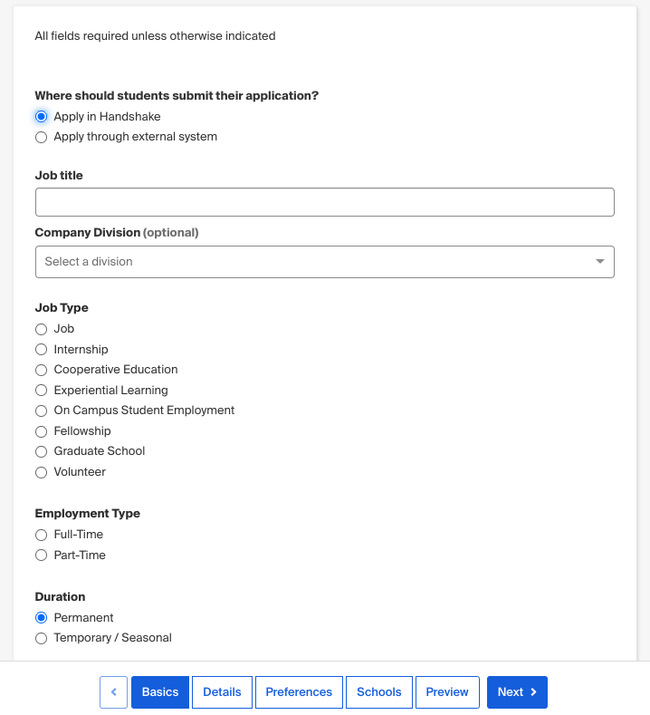
Posting Jobs
If using external ATS:
Add source code
Uncheck required documents
Connecting with candidates: indicate if open to messaging and/or virtual info chats
Details: the more descriptive you can be (while avoiding jargon!), the better a candidate can assess their fit
Preferences: ID any work authorization, graduation date, GPA + major preferences
Schools: post to selected schools - we suggest posting to all to ensure a more diverse candidate pool!
Notes:
Posting a job is quick and easy- go to the jobs tab in your left hand navigation bar - then click “create job”in the upper right hand corner
Follow prompts via 4 quick tabs
First decision is whether you will ask applicants to apply in HS or via your external ATS - If asking students to submit their application via your external ATS:
Add source code to track candidates coming from Handshake
Uncheck required documents from candidates (resume,etc) to avoid redundant steps for candidates
Connecting w candidates: this can be a great way to stand out from the pack - if you click that you are open to messaging, interested candidates will be able to send you a message from handshake. You also have the option to set up an availability calendar to set up 15 min virtual info chats to help answer candidate questions
Details: enter in all details about the job - recommendations here:
Be descriptive
Avoid jargon
Emphasize skills over experience - focus on coursework, skills, certifications. Keep in mind most candidates on Handshake are very early on in their career journey
Include skills building opportunities on the job
Helpful to include any info about the application process, eligibility, duration, job type, benefits
Salary optional but strongly recommended to be transparent - 65% of students say salary range in job postings is the greatest motivator to apply
Examine nice to have vs need to have qualifications and remove barriers whenever possible
Students who do not meet your work authorization, graduation date, GPA, and major preferences will still be able to apply, but we’ll highlight which ones don’t match (and let you filter them out)

Slide 10
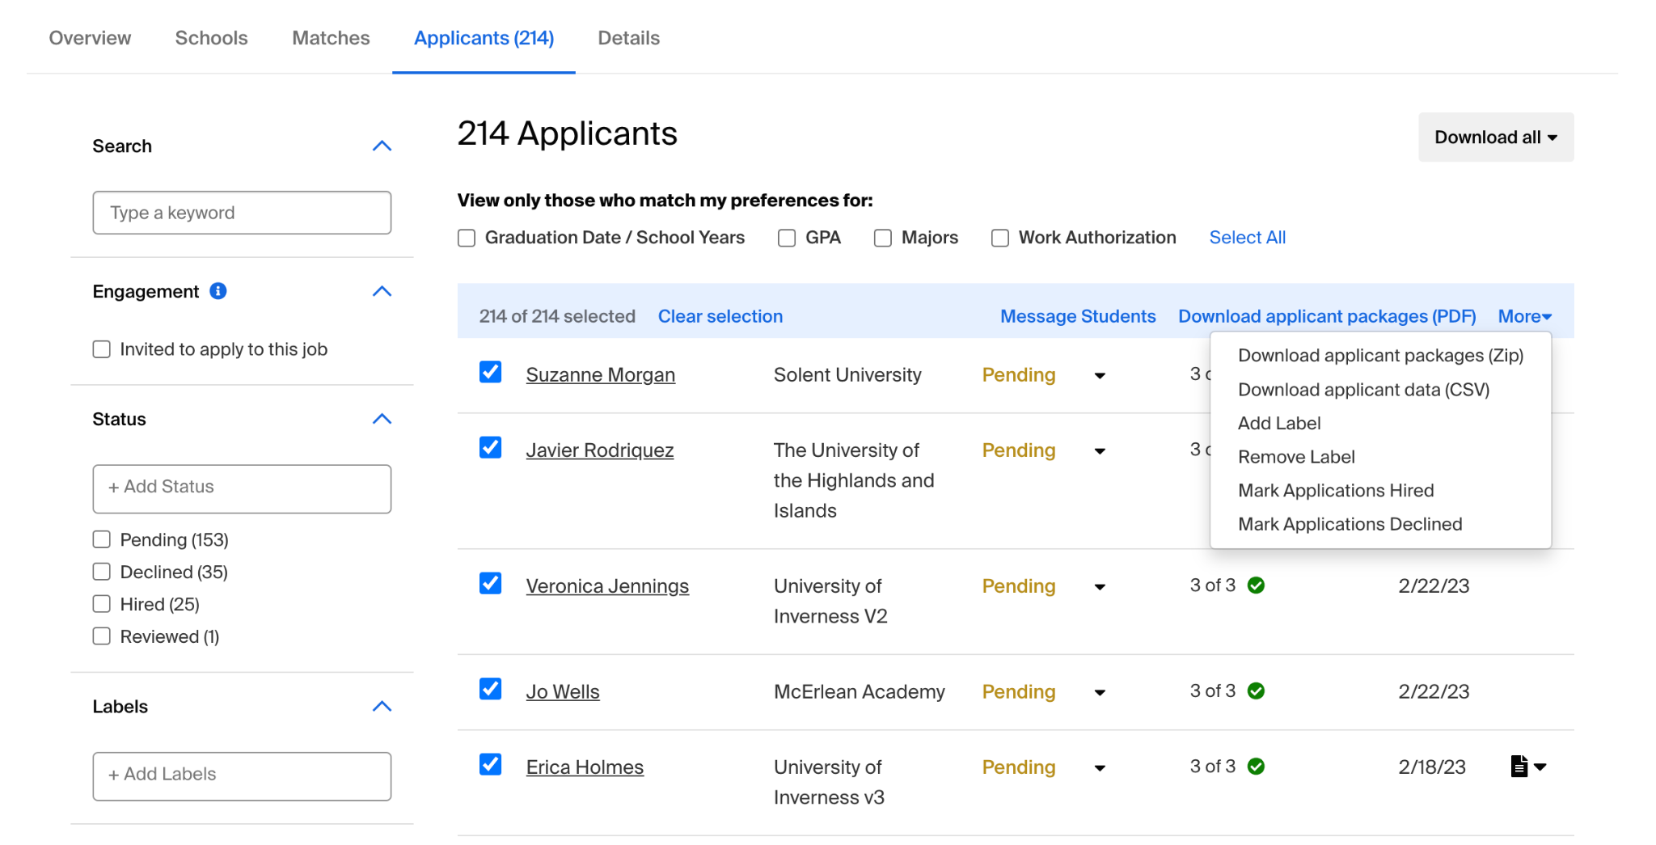
Tracking Progress
Overview: snapshot of total applicants, total who meet all preferences and your overall reach
Schools: provides recommendations of additional schools to consider posting to and full details of job status, applications received, etc by school you’ve posted to
Matches: applicants who meet all of your preferences
Applicants: list of all with ability to filter based on preferences + take bulk actions (message, download applicant packages, update applicant status)
Notes:
Click into a job posting to access some quick analytics and recommendations- the overview tab will give you a snapshot of your reach - how many candidates have applied? How many of them match your preferences?
Schools: provides additional recommendations of schools to post to based on the # of candidates at each school who match your preferences
Matches: presorted list of candidates who meet all your preferences and a view of all applicants
Applicants: view all applicants - select one or several to message, download applicant packages, update applicant status, add labels
From this page you can also access all details related to the job posting and take more actions like expire a job or duplicate a posting

Slide 11
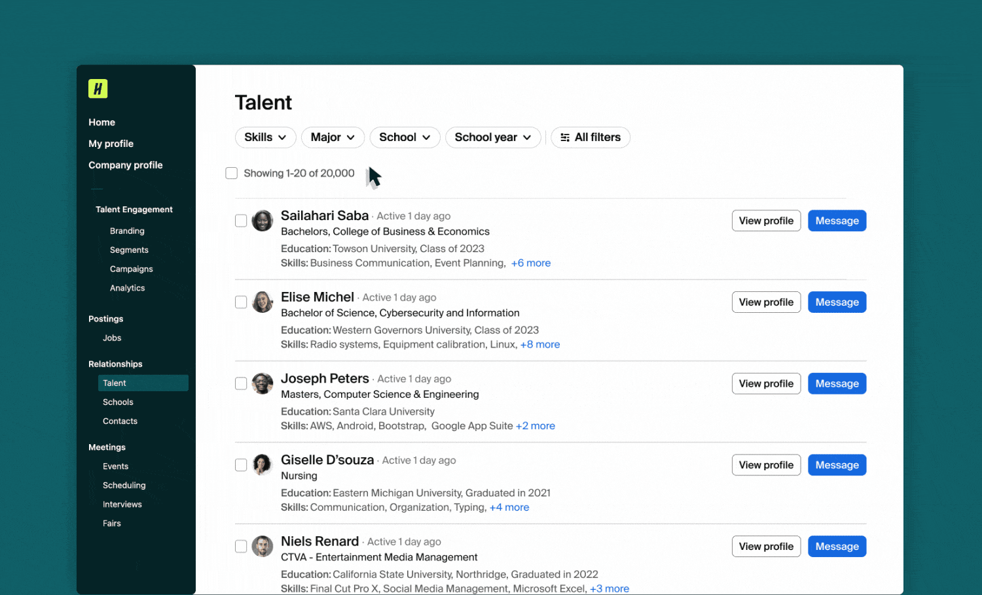
Messaging
Inbox: access from Handshake or your email inbox
Talent: use filters to narrow down results + identify students to message
Event RSVPs: navigate to upcoming event + use RSVP tab to message students in advance and/or following an event
Best Practices: personalization, brevity and a clear Call to Action
Notes:
Messaging is a key tool available to you on Handshake: it can be used to build relationships w job seekers, raise awareness about your org and open roles, drive event registrations and fill your talent pipeline. As a non paying employer in Handshake, you can send up to 100 messages per recruiting season to drive engagement with candidates at your approved schools
Your inbox: You can log into HS to respond to messages or reply directly from your email - we recommend keeping an eye on these and responding to provide an encouraging student experience
Where you can message students:
1: Talent (under relationships):Students and alum who show up here attend a school you are connected with and approved at and have opted in to having their profiles viewable by employers. Narrow it down using filters - keyword search, skills, school, school year, grad date, GPA, labels, primary college- can then use messaging to reach out directly to encourage they apply for a role or attend an event youre hosting
2 Event or fair RSVP tab - navigate to upcoming event and click on RSVP tab - message students to send reminder pre or post event - note that messages to students who have RSVPed to an event or fair do not count towards the limit. More on messaging limits here: https://support.joinhandshake.com/hc/en-us/articles/1500004973301
Messaging best practices: personalization, brevity, clear CTA is shown to yield the highest response rates! More on messaging and best practices, including sample templates in Handshake Pathfinders course here: https://training.joinhandshake.com/core-messaging/1459237

Slide 12
Connecting Live in Handshake
Virtual Career Fairs: Browse Fairs Coming up via the fairs tab and/or respond to exclusive invitations schools share. Set your schedule to host 30 min group sessions and/or 10 min 1:1 individual video chats.
In-Person Career Fairs: Attend an in-person career fair hosted by a school - consider following up with an on-campus interview schedule while you are on campus!
Events: A great way to raise brand awareness + provide prospective applicants with valuable insight. Can be hosted in person or virtually - publish event + request approval at schools.
Students who engage 1-1 with employers are 36% more likely to apply to jobs with that employer
Virtual Info Chats: Set and share an availability calendar to host 15 minute informal video chats with prospective candidates.
Notes:
One of the key differentiators b/w HS and other job board platforms is the ability to connect live w candidates! Events and fairs offer an important avenue for your team to build rlshps w prospective candidates and source top talent - we know for example that across the Handshake network, 75% of students who sign up for a career fair session view an employer, browse a job or apply for a job within the week in advance of a fair.
Fairs happen both virtually and in peson. For virtual fairs, you can register by either responding to an invite you received from a school and/or by proactively browsing via the fairs tab and searching for virtual or in in person fairs. For virtual fairs, you will be prompted to set your schedule once you register and can host 30 min group sessions and/or 10 min 1-1 sessions. Handshake allows you to do all scheduling, stream through their video or your preferred video meeting software and to communicate in bulk with all who RSVP for your sessions, both in advance and following a fair. In person fairs allow you to register and communicate with RSVPs in advance and following up. Starting Fall 23, you can also get stats on what students visit your booths on campus and can use that info to follow up with candidates afterwards as well
Events are hosted by you - you can create these in the events tab and then request to promote them at the schools you desire. Can be hosted virtually or in person and you can communicate directly w RSVPs and attendees pre/post
VICs - great way to connect informally outside of scheduled group events and fairs!

Slide 13
Handshake Key Resources
Free online Pathfinders course for live demos on how to get started as a non-paying employer in Handshake
Key blog posts to get started: Showcasing your brand, 5 tips to improve your JDs, How students explore careers + engage with employers on Handshake
Handshake Help Center: documented instructions on how to get started overall and dive into specific features
Contact Support: submit a ticket with Handshake’s support team - answer prompts to identify yourself as an employer + submit your question for assistance.

